Slide 1
Advanced Sprint –Part 5
Power BI Report directing to SSRS report, passing Dynamic parameters

Slide 2
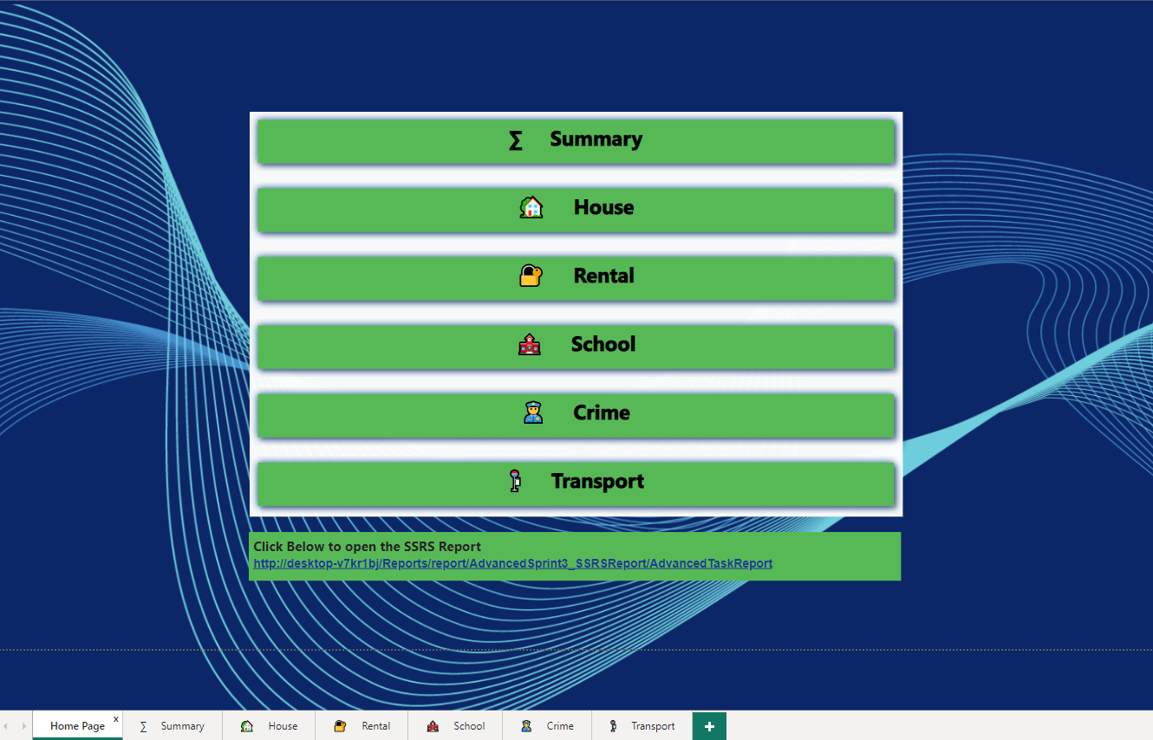
Deploy your SSRS reports to the SSRS web portal, now we will link Power BI dashboard to SSRS paginated report

Slide 3
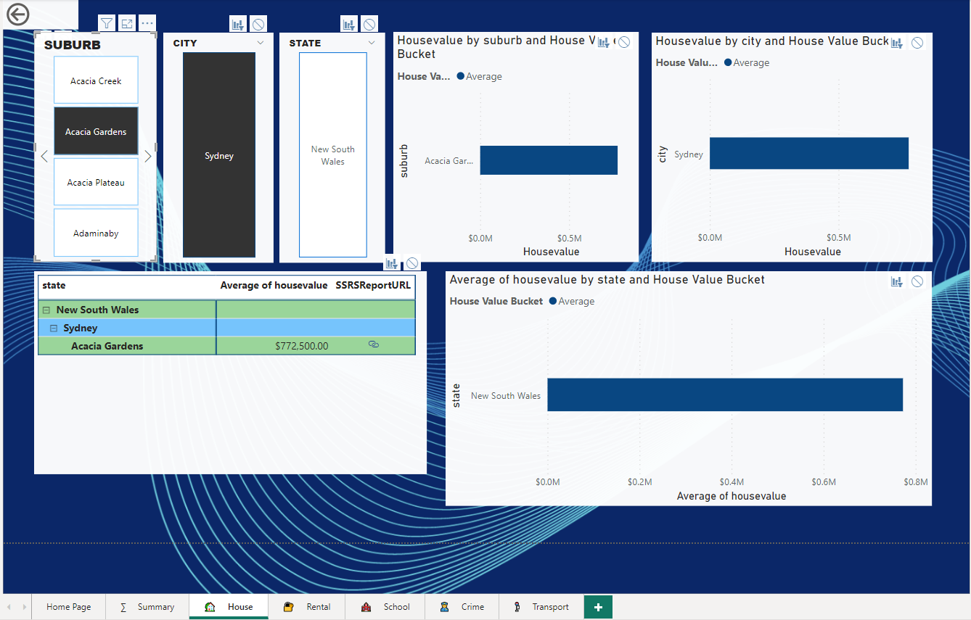
House Value Page

Slide 4
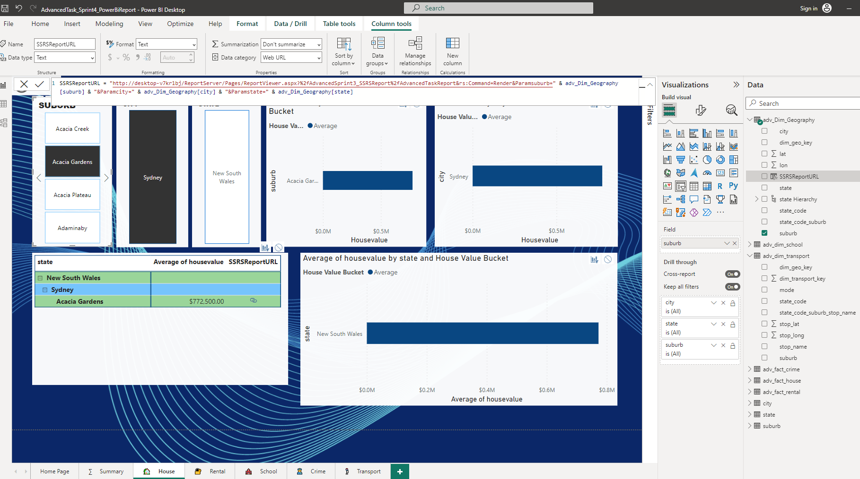
House Value Page – SSRS dynamic report – measure created for the web link

Slide 5
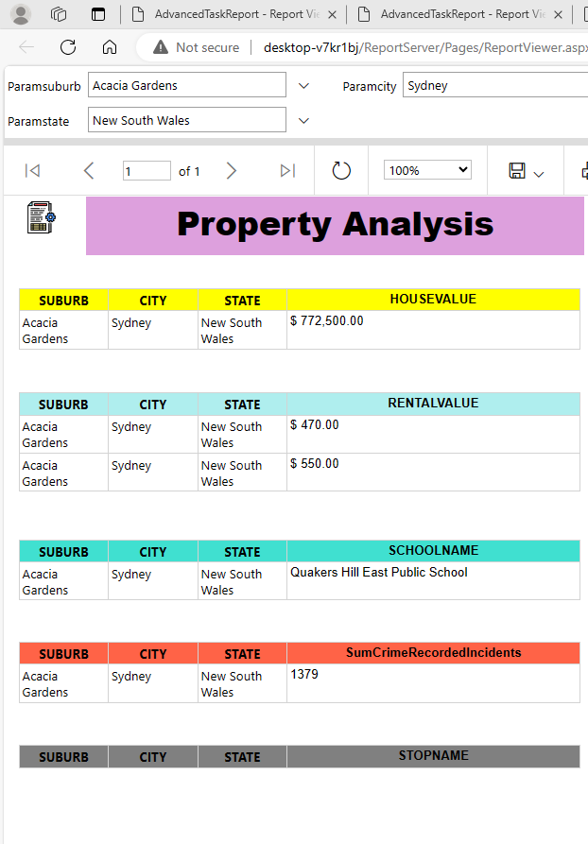
House Value Page – SSRS dynamic report – Web Portal with inbuilt values

Slide 6
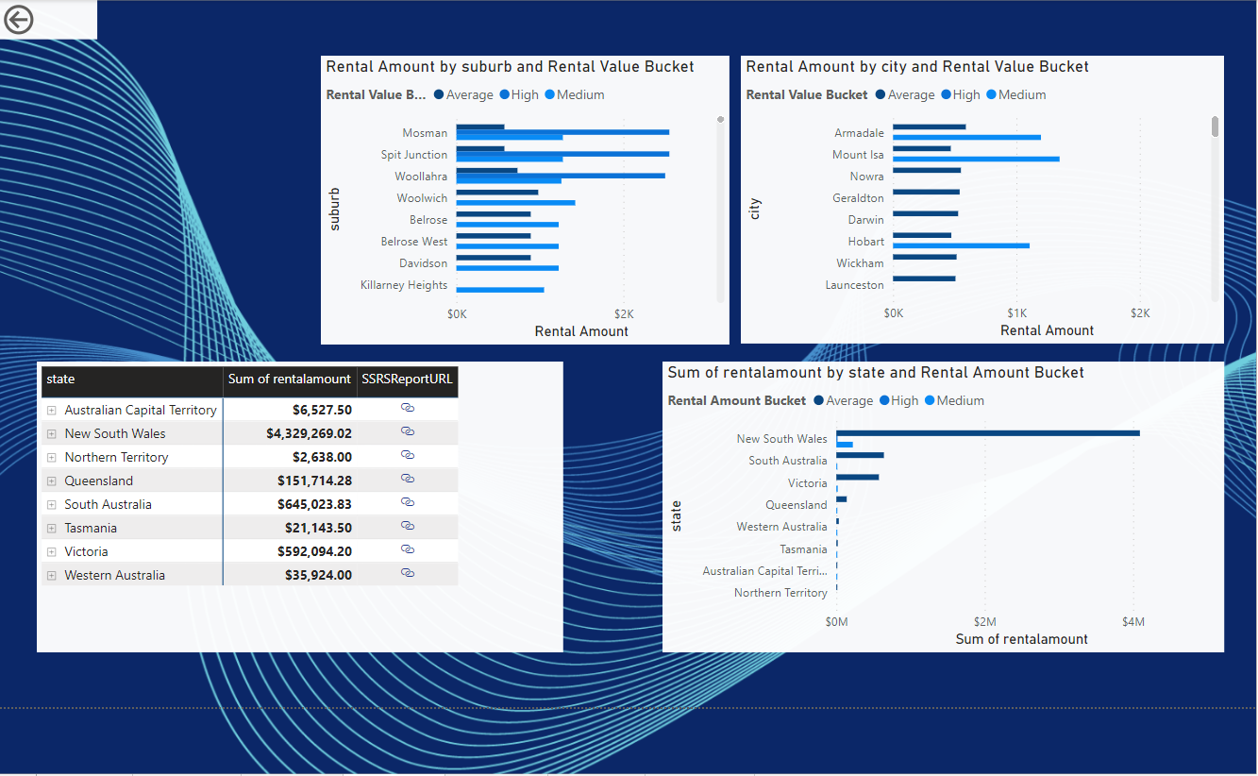
Rental Value Page

Slide 7
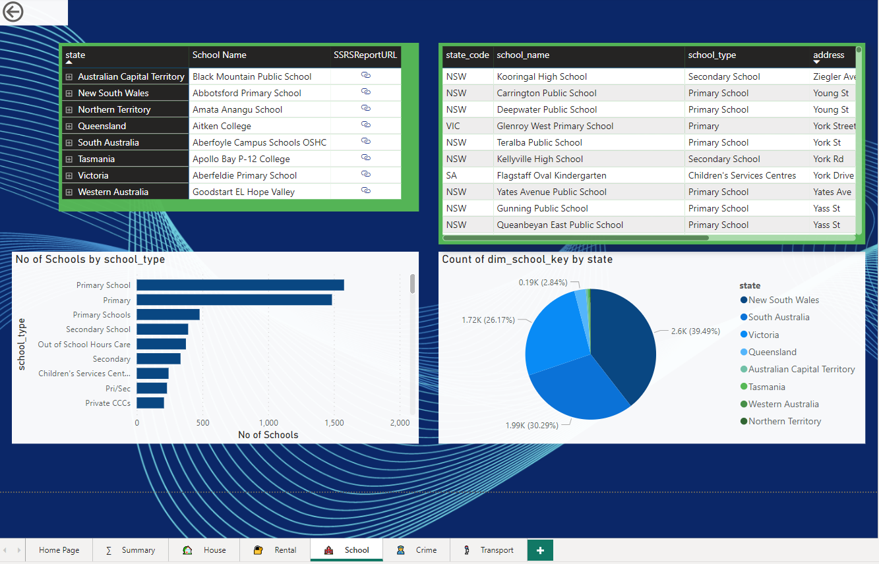
School Page

Slide 8
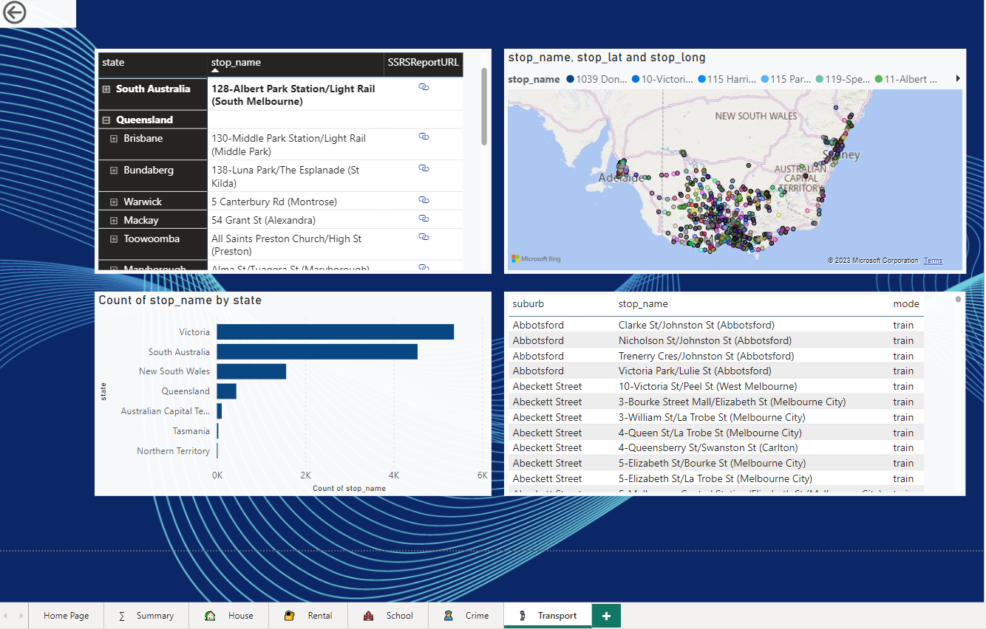
Transport Page

Slide 9
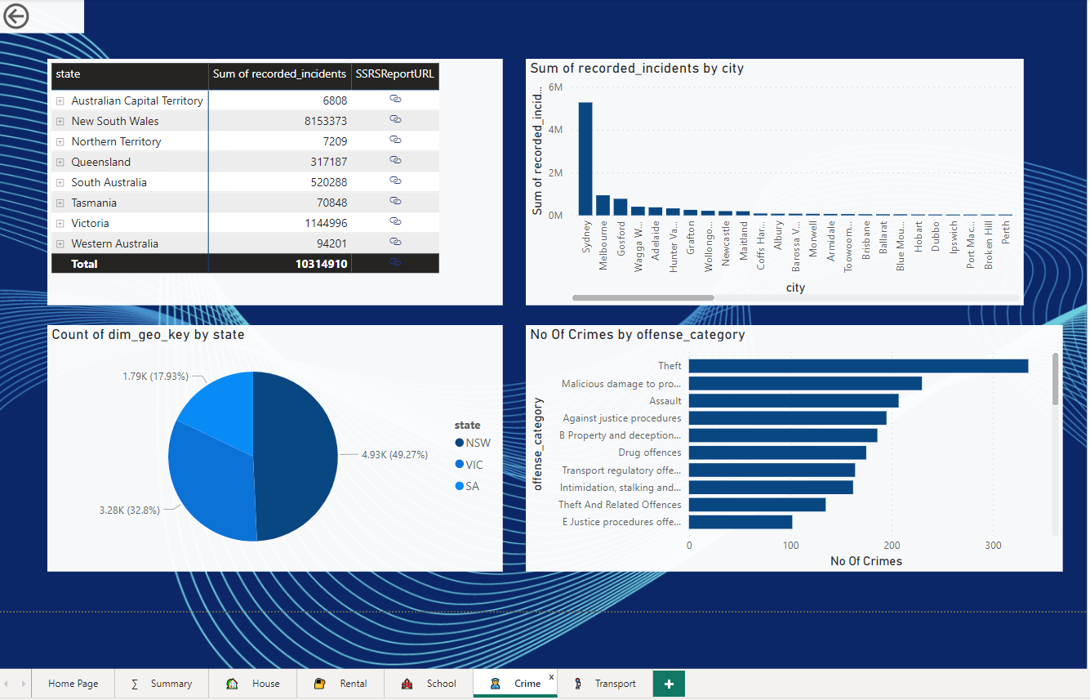
Crime Page

